Slide 1
Batch2 Results Breakdown
11/21/2020

Slide 2
Recapping the Task
After each presentation, ask subject
Did you see the middle face? → press 0 if not 1 if yes.
“Confidence Variable” is the mean of this binary distribution.
Was the middle face neutral or disgust → press 0 if neutral 1 if disgust
“Performance Variable” is the mean of this binary distribution
150 Trials
10 Participants ➔ 1,500 trials total

Slide 3
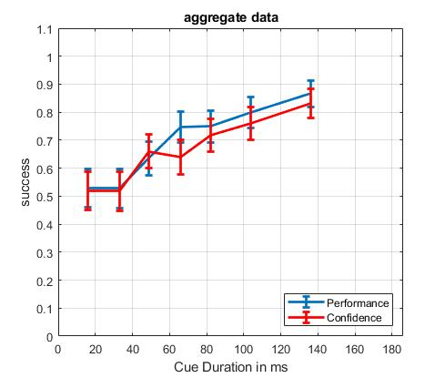
Aggregate Results

Slide 4
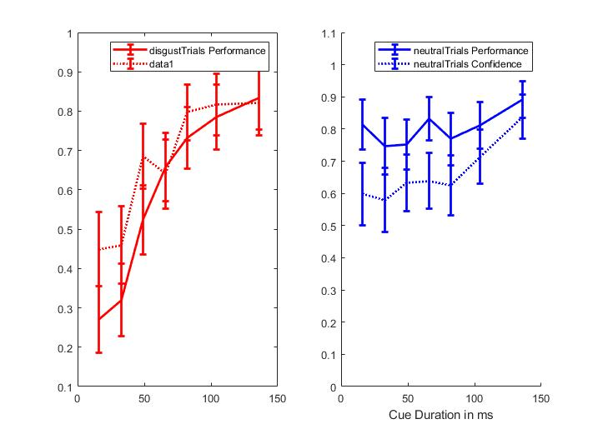
Breakdown by Neutral/Disgust Faces
Note how confidence is opposite for neutral/disgust at the lowest duration.
Therefore, above aggregate_figure in the last slide may seem “fine,” but if we were asked to test for interaction between confidence and choice, there would be a huge interaction.
This is a problem because the most likely explanation is that Mturkers cannot distinguish between cue face and neutral mask.
I have a potential solution in the last slide.

Slide 5
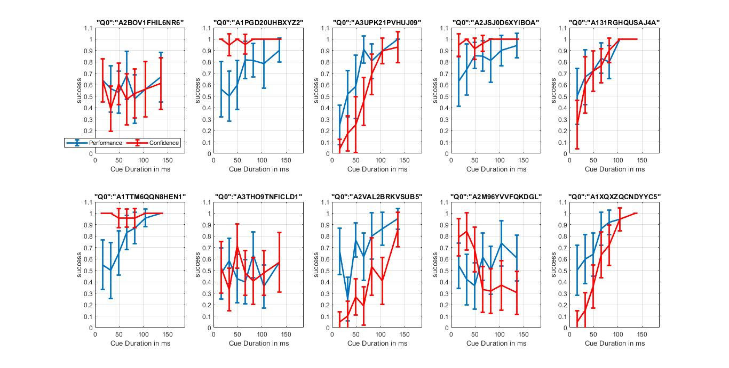
Individual/Worker Results

Slide 6
Purpose
Time Calibration → Finding the “sweet-spot” where performance>chance but confidence is still at ~50% or lower.
Because of bias/not-understanding task problems, not sure how to get at this data
Makes sense then to just use the durations at which performance at 2AFC is in the “threshold” between chance and > chance. No problem casting a wider net, right?
Collect data on subjective awareness
I have a solution that I think will be helpful

Slide 7
My interpretation
I will argue that instead of making participants do 2AFC (was face neutral or disgust?), or asking them if they saw the middle face, we should instead simply ask them, (“did you see a disgust face?”).
Asking people this question would result in the same data as the current task (confidence+decision), but it has the advantages of being simpler (only one key-press) and being much less confusing (doesn’t require that participants distinguish the neutral mask from the cue face – which I argue below our participants cannot do)
Evidence that Mturkers still cannot distinguish between middle/cue face and last/neutral mask:
As shown in the individual results, some Mturkers are 100% confident at the shortest duration even though their performance is ~50% (
In the bias figure (slide 4), neutral_confidence is always inexplicably >0.5 at the lowest cue_duration.
Phenomenologically, the task really feels like “seeing a disgust face or seeing nothing.” The questions hints at an optimal strategy for doing the task, which, were it not asked, participants would no doubt learn over trials anyways (I highly recommend doing the task for 100+ trials).

Slide 8
For Memory Task…
I understand that asking people, “did you see the disgust face” might be probelematic insofar as it explicitly hints at a subliminal blind, and therefore might have some confounding effect on awareness.
I think it makes sense to run the memory task for some X trials without this query of subjective awareness, and then run the last Y trials w/o asking.

Slide 10
If we are only asking these questions to learning which cue_duration to use…
… (and not because we want to incorporate subjective report in our final experiment).
Then it makes sense to focus our interpretation on the disgust trials subplot of the bias graph – because the neutral trials subplot is very obviously confounded by the fact that people conflate neutral mask with target.
Indeed, this confusion might also be confounding the disgust_trials data (confidence will be artificially lowered b/c of simultaneously high confidence in neutral mask being neutral target). But we can overcome this by focusing only on performance not confidence data, and with the rationale that disgust faces are more salient, so “if you saw disgust you are more likely to really report that you did.”
As such, we can see that the “subliminal zone” is roughly 16ms-116ms

